Slide 1
Regression Intuitions
Shameek Bhattacharjee
Western Michigan University
Scribe: Jordon Matthew Heyboer
This material was developed as part of NSF OAC-2017289

Slide 2
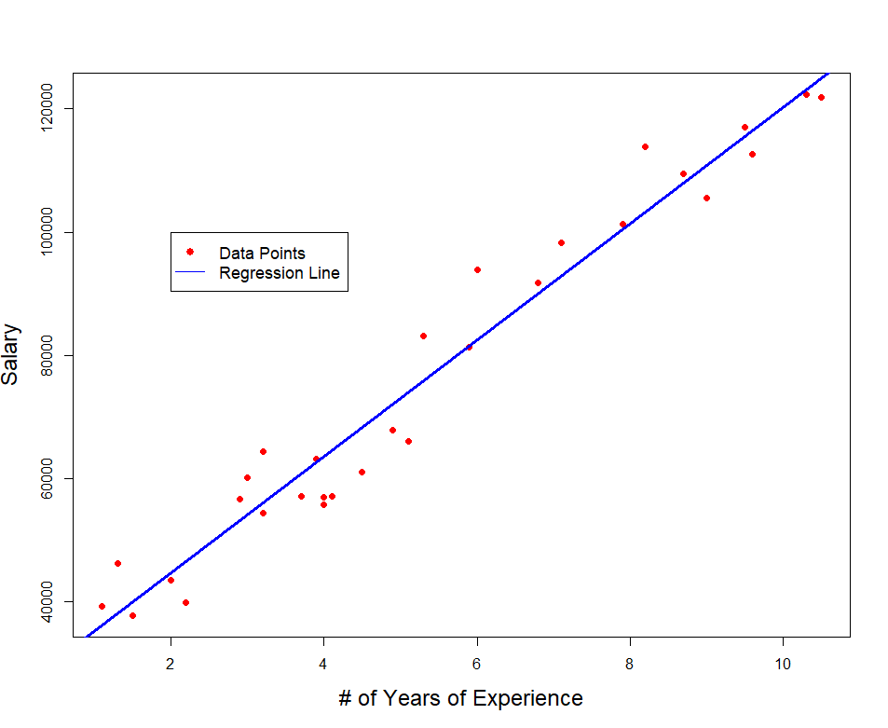
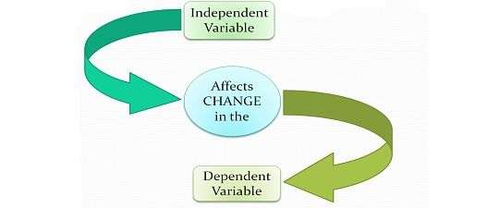
What is Regression?
Regression allows prediction of a value taken by a dependent (response) variable given a value for the input independent variable
The thing which allows prediction is a function that captures the input’s relationship with the response.
The function for example could be as simple as a line, or a little more advanced like a polynomial, and very complex such as neural network.
Since we focus on relationships, you need to have an idea of which of the variables(dependent) have a possibility of being reliant on what factors (i.e. independent variables)

Slide 3
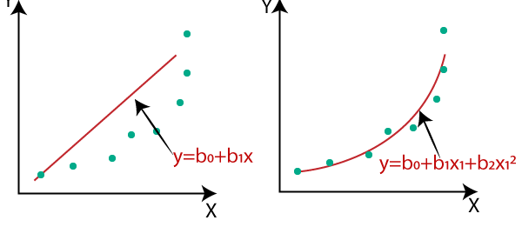

Understanding Function Approximation
Function f(x) → is mathematically specified by parameters that characterize the choice of function
Linear Function
Polynomial Function
e.g. $b_{1}$and $b_{o}$
are parameters when
F(x) is a line
Why?
$b_{1}$ represents the slope
And $b_{o}$ is the
Y-intercept both of which
Are necessary to complete the equation
Of a line.

Slide 4
What is it mean to learn the relationship
In most supervised ML, we care about learning the relationship via a function.
The function is nothing but a set of unknown parameters.
So we need to find out “learn” what the best parameter values are
E.g. knowing the best value of slope and intercept will allow us to find the best line that represents the relationship between independent variable(s) and the dependent variable in the “best possible” way
How to know best → set a goodness criteria→ Cost Functions

Slide 5
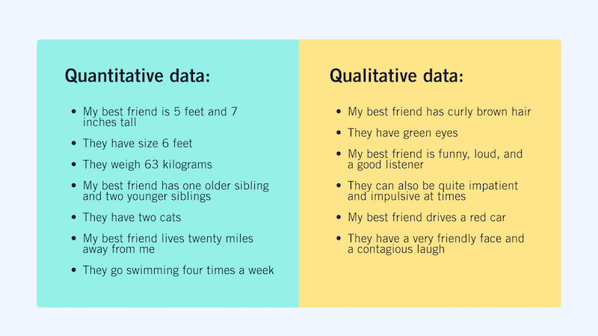
Regression vs Classification
In Machine Learning, we are looking to build models/algorithms to predict our independent variable.
Regression tries to predict a quantitative continuous valued output
Classification tries to predict a output that is qualitative or categorical in nature
Example using weather data:
Regression: Predicting the expected temperature at a this time of the year and at this location.
Classification: Predicting if the weather will be: Sunny, cloudy, rainy, etc
Regression
Location and Time of the Year → Independent
Variables
Temperature → Dependent Variable
Classification
Will today be sunny → Yes or No (dependent variable)
What will be the weather like → Sunny, Rainy, Cloudy

Slide 6
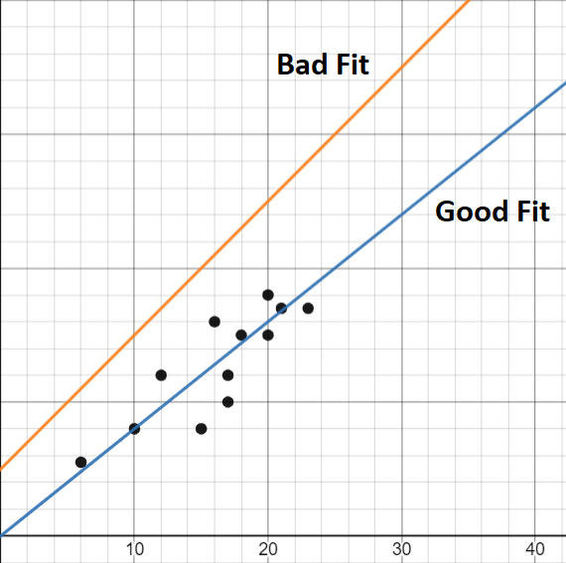

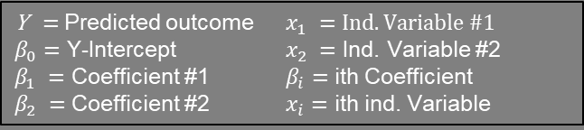
How does Regression work?
Trial and Error on different candidate parameter values that could specify a function and see which ones the best.
Regression Equation
how one regression model (i.e. one candidate parameter choice) performs compared to another, we need to have some benchmark to compare. This is what Empirical Risk (Cost Function) is used for.
Empirical Risk is a value assigned to the “goodness” of each candidate parameter choice to the entire (training) dataset.
The lower the empirical Risk, the better the regression model agrees to the data.
Empirical Risk Minimization is a fundamental in statistical learning and is naturally our goal here.
Y$=β_{0}+β_{1}x_{1}+β_{2}x_{2}+…+β_{i}x_{i}$
Y = Predicted outcome $x_{1} =Ind. Variable \#1$
$β_{0}=$ Y-Intercept $x_{2} =$ Ind. Variable #2
$β_{1} =$ Coefficient #1 $β_{i}=$ ith Coefficient
$β_{2} =$ Coefficient #2 $x_{i}=$ ith ind. Variable

Slide 7
Empirical Risk (cost function) vs loss function
Loss Function
It works similar to empirical risk by giving the general definition of goodness of the parameter choice but w.r.t a single training data point.
“Usually” the cost function value against a candidate parameter choice is mean of loss values for all training datapoints
Using the Empirical Risk values, we can judge the “goodness” of each fitted model.
Our computers can generate and compare all combinations of parameter choices, using their empirical risks.

Slide 8
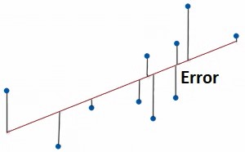
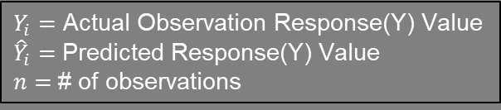

One way to find Empirical Risk: Mean-Squared Error
For each regression model choice, the distance from each observation/datapoint to that line (produced by this current model choice) is measured. This is simply called the error(or residual), or how inaccurate our prediction was.
One way to calculate Empirical Risk is by finding the mean-squared error.
Like the title says, each of the errors will be squared, and will then take the average of those resulting numbers, hence the name Mean-Squared Error.
This leaves us with one value which we can assign to that model. Repeating this process for each model will function as our empirical risks to which we can compare.
This process is also called Least Squares.
$$MSE=\frac{1}{n}\sum_{i=1}^{n}{{(Y_{i}−{\hat{Y}}_{i})}^{2}}$$
$Y_{i}=$ Actual Observation Response(Y) Value
${\hat{Y}}_{i}=$Predicted Response(Y) Value
$n=$# of observations
Since for each datapoint we are taking a square
Of the difference between the datapoint and the
Candidate parameter fit ; loss function == squared
residuals

Slide 9


Loss Function & Cost Function
Loss Function:
$${(Y_{i}−{\hat{Y}}_{i})}^{2}$$
Whenever measuring Empirical Risk, it is important to know what role the loss function plays.
The Loss Function is simply the formula used to calculate the Empirical Risk for each training data point/observations.
For Least Squares in the previous slide, our Loss Function was the equation used to caluclate each error/residual.
In principle, the Cost Function is measuring the same thing as the loss function, but focuses on the empirical risk assigned to the model instead of point-by-point.
Cost Function:
$$\frac{1}{n}\sum_{i=1}^{n}{{(Y_{i}−{\hat{Y}}_{i})}^{2}}$$

Slide 10
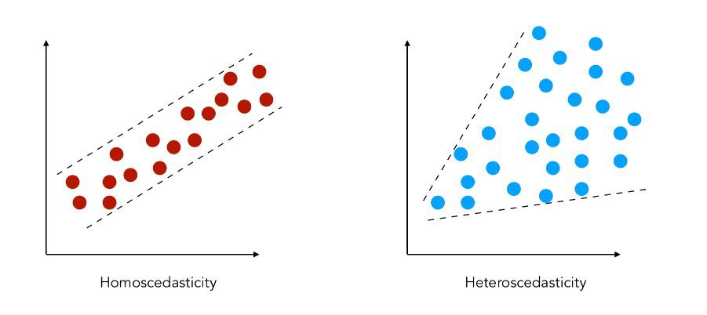
Problems with Regression
An important vulnerability with regression is its assumption that the errors are normally distributed.
Referring to the two graphs, we can see that in the left graph there is a consistent variance in erros, while the right graph has an increasing variance as the independent variable increases.
This pattern of changing variances is called Heteroscedasticity. Notice if we were to fit a line to the graph on the right, the predictions would worsen as we move to right.
Another problem is the instance when the data sets we work with include observations of extreme values(outliers) that values that are vastly different from the majority. This will cause our predictions to be worsened.

Slide 11
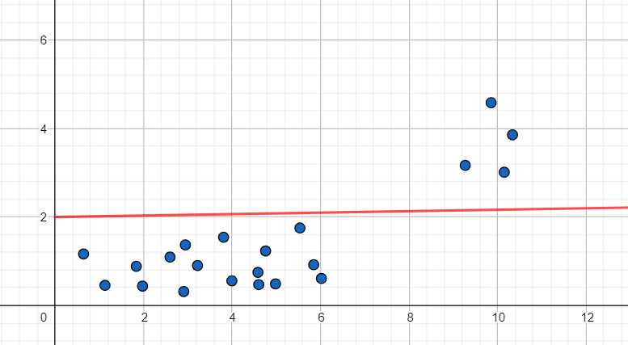
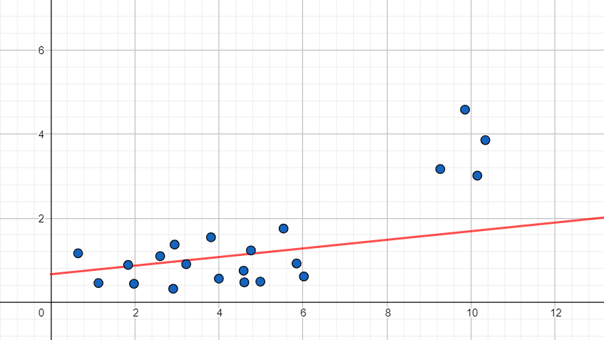
Accounting for Outliers
If we are given data that looked like this, where we can see two distinct groups. We would want to account for these outliers somehow.
A way to account the empirical risk for this is by adding weights to the errors.
If our desire is to improve prediction of the most common observations, then adding these weights should help us do that.
So instead of minimizing the sum of squares, we are going to minimize the sum of weighted squares.

Slide 12
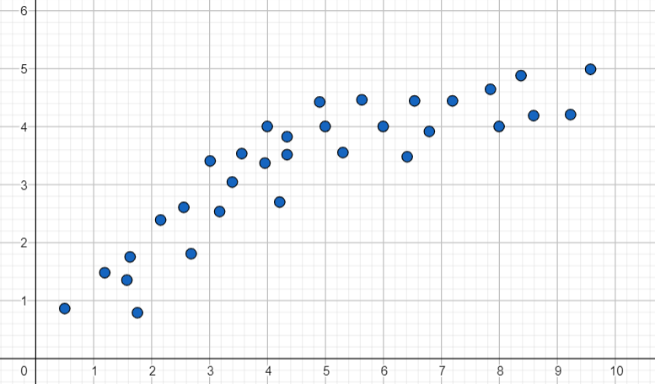
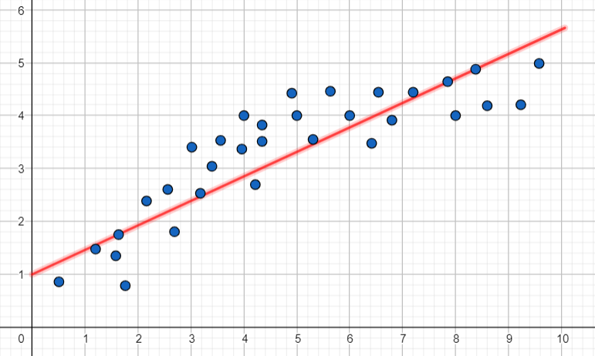
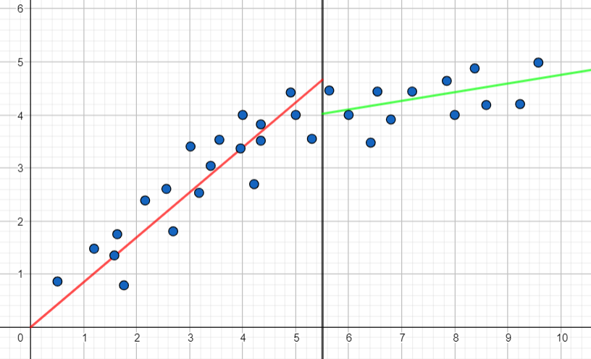
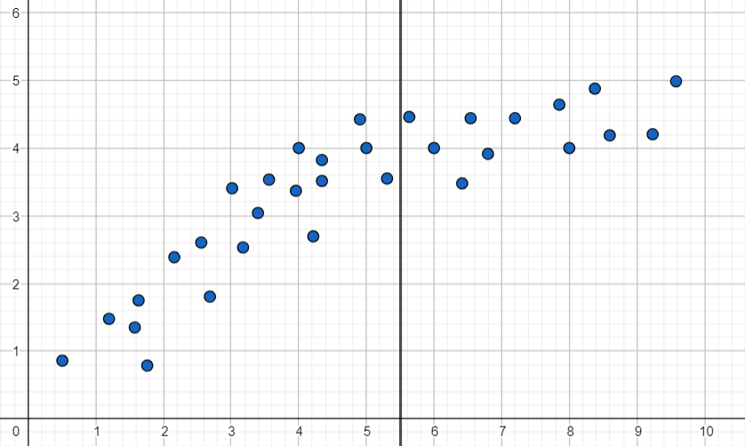
One way to Account for Heteroscedasticity
(A) Using these data points as an example, our linear regression model might look like this.
(D) Now, if we fit regression lines but treated the data on either side of the line as separate, we can see we have two regression models that give us better predictions.
(B) We might not think much of this model, but we can see that most predictions in the center are generally too low, and the ones on the right and left are generally too high.
(C) Adding this vertical line can show some seperation between the general patterns of the data on the left and the right.

Slide 13
Conclusion
We understood regression and got into the specifics of linear regression
In a later module we will understand why this is vulnerable to attacks like false data or even a large number of outliers.
In a later module we would also like to get an insight of “why” the loss function was a square of the residuals and what good comes out of it.
In a later module, we talk about how to deal with problem of heteroskedascity

